Slide 1

On the Numeric Techniques for Problems in Physics
Presentation by Patryk Kwoczak

Slide 2
What Is The Objective?
Given some physical laws describing a system, how can we simulate the true evolution through time of the system?
Physical Laws described by Differential Equations
How can we examine the accuracy of our results?
What is ‘good enough’ and how do we do better?
What do we need to be mindful of?
What problems arise?

Slide 3
My Background
Learning Outcomes
Applied Math Major interested in computational math
Took a Numerical Methods course which described numeric ordinary differential methods
Some experience with Python examining complex root-finding algorithms and their dynamical structure.
Learned to deal with how the methods are only as good as the limitations of the physical system they are modelling.
Learned how to manipulate the mathematics to produce the right equations necessary.
Learned about Symplectic Integrators which utilize the symmetry of the physical system to more accurately model it.

Slide 4
Techniques and Tools
The Methods:
Euler’s Method
Fourth-Order Runge-Kutta
Symplectic Euler
Verlet and Verlet-Velocity
I took these tools and applied them to the physical situations they could be used in, such as the shape of a hanging rope, the path of fastest descent, and the Celestial Orbit of a planet.

Slide 5
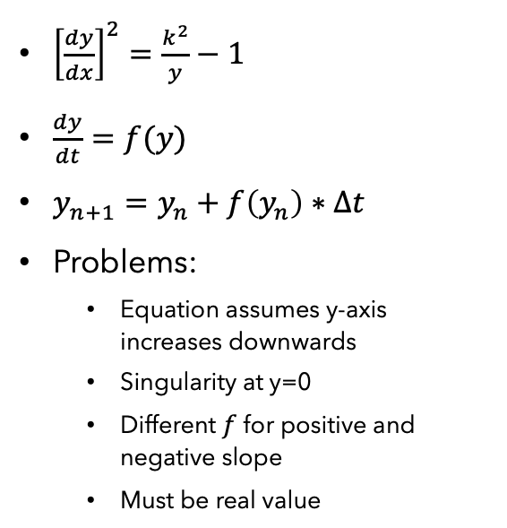
Euler’s Method
${\left[\frac{dy}{dx}\right]}^{2}=\frac{k^{2}}{y}−1$
$\frac{dy}{dt}=f(y)$
$y_{n+1}=y_{n}+f\left(y_{n}\right)∗Δt$
Problems:
Equation assumes y-axis increases downwards
Singularity at y=0
Different $f$ for positive and negative slope
Must be real value

Slide 6
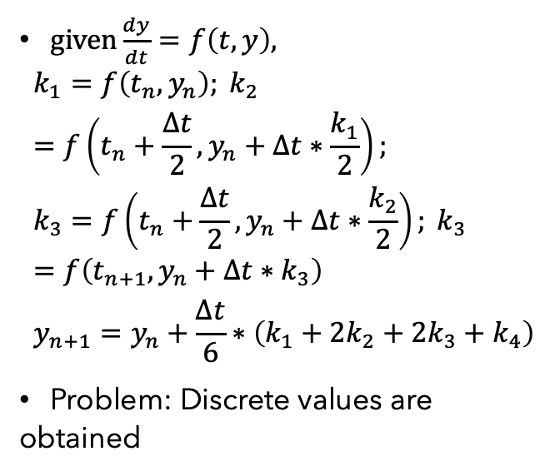
Runge-Kutta Fourth-Order (RK4)
$given\frac{dy}{dt}=f\left(t,y\right),$ $k_{1}=f\left(t_{n},y_{n}\right); k_{2}=f\left(t_{n}+\frac{Δt}{2}, y_{n}+Δt∗\frac{k_{1}}{2}\right);$ $k_{3}=f\left(t_{n}+\frac{Δt}{2}, y_{n}+Δt∗\frac{k_{2}}{2}\right); k_{3}=f\left(t_{n+1}, y_{n}+Δt∗k_{3}\right)$ $y_{n+1}=y_{n}+\frac{Δt}{6}∗\left(k_{1}+2k_{2}+2k_{3}+k_{4}\right)$
Problem: Discrete values are obtained

Slide 7
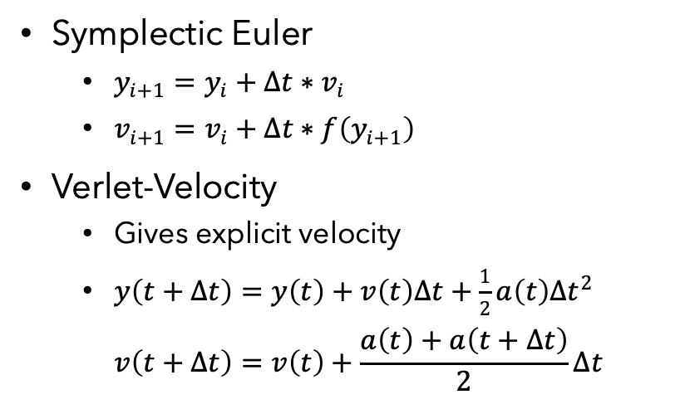
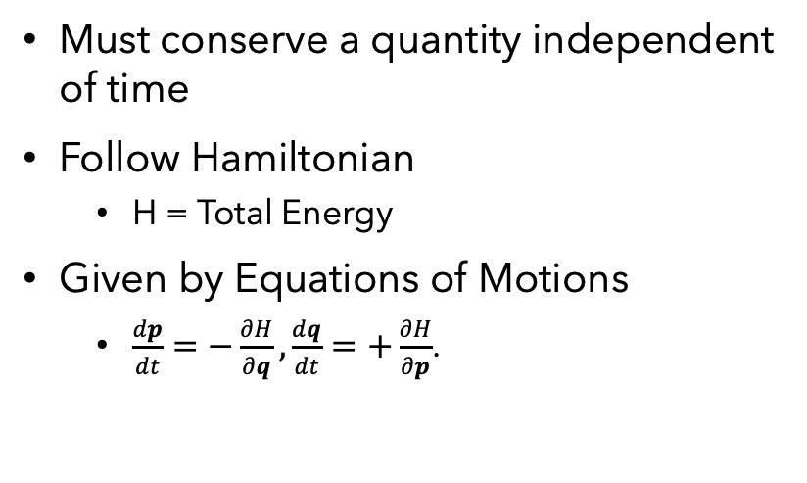
Symplectic Integrators
Good for certain systems
The Methods
Must conserve a quantity independent of time
Follow Hamiltonian
H = Total Energy
Given by Equations of Motions
$\frac{dp}{dt}=−\frac{∂H}{∂q},\frac{dq}{dt}=+\frac{∂H}{∂p}$.
Symplectic Euler
$y_{i+1}=y_{i}+Δt∗v_{i}$
$v_{i+1}=v_{i}+Δt∗f\left(y_{i+1}\right)$
Verlet-Velocity
Gives explicit velocity
$y\left(t+Δt\right)=y\left(t\right)+v\left(t\right)Δt+\frac{1}{2}a\left(t\right)Δt^{2}$ $v\left(t+Δt\right)=v\left(t\right)+\frac{a\left(t\right)+a\left(t+Δt\right)}{2}Δt$

Slide 8
Symplectic vs. Euler
Symplectic solves an approximate Hamiltonian Exactly
Preserves area of trajectory (Doesn’t escape)
Standard Euler solves exact system approximately
Error builds up and escapes correct orbit

Slide 9
Symplectic Euler vs Varlet
Both Very similar

Slide 10
References
1: “Brachistochrone Problem.” From Wolfram MathWorld, mathworld.wolfram.com/BrachistochroneProblem.html.
2: “Catenary.” From Wolfram MathWorld, mathworld.wolfram.com/Catenary.html.
4: Chai, Patrick, and Evan Anzalone. “Numerical Integration Techniques in Orbital Mechanics Applications.” Research Gate, doi:10.13140/RG.2.1.1474.2243.
4:Rosenthal, Mike, “Numeric Integration of Orbits – A Crash Course” presentation, https://people.ucsc.edu/~mmrosent/talks_notes/num_int_pres.pdf

Slide 11
Thank you ☺

